Slide 1
RDBMS Presentation
Relational database management system

Slide 2

Table of Contents
What is MySQL
What is PostgreSQL
What is SQL SERVER
comparison between this three RDBMS

Slide 3
What is MySQL ?
MySQL is an open-source relational database management system(RDBMS).Its name is a combination of "My", the name of co-founder Michael Widenius's daughter, and "SQL", the abbreviation for Structured Query Language. A relational database organizes data into one or more data tables in which data types may be related to each other; these relations help structure the data. SQL is a language programmers use to create, modify and extract data from the relational database, as well as control user access to the database.
Many of the world's largest and fastest-growing organizations including Facebook, Google, Adobe, Alcatel Lucent and Zappos rely on MySQL to save time and money powering their high-volume Web sites, business-critical systems and packaged software.

Slide 4
What is PostgreSQL ?
PostgreSQL is a powerful, open source object-relational database system that uses and extends the SQL language combined with many features that safely store and scale the most complicated data workloads. The origins of PostgreSQL date back to 1986 as part of the POSTGRES project at the University of California at Berkeley and has more than 30 years of active development on the core platform.
PostgreSQL has earned a strong reputation for its proven architecture, reliability, data integrity, robust feature set, extensibility, and the dedication of the open source community behind the software to consistently deliver performant and innovative solutions. PostgreSQL runs on all major operating systems, has been ACID-compliant since 2001, and has powerful add-ons such as the popular PostGIS geospatial database extender. It is no surprise that PostgreSQL has become the open source relational database of choice for many people and organisations.

Slide 5
What is SQL SERVER ?
Microsoft SQL Server is a relational database management system developed by Microsoft. As a database server, it is a software product with the primary function of storing and retrieving data as requested by other software applications which may run either on the same computer or on another computer across a network (including the Internet).
Similar to other RDBMS software, SQL Server is built on top of SQL, a standard programming language for interacting with the relational databases. SQL server is tied to Transact-SQL, or T-SQL, the Microsoft’s implementation of SQL that adds a set of proprietary programming constructs.
SQL Server works exclusively on Windows environment for more than 20 years. In 2016, Microsoft made it available on Linux. SQL Server 2017 became generally available in October 2016 that ran on both Windows and Linux.

Slide 6
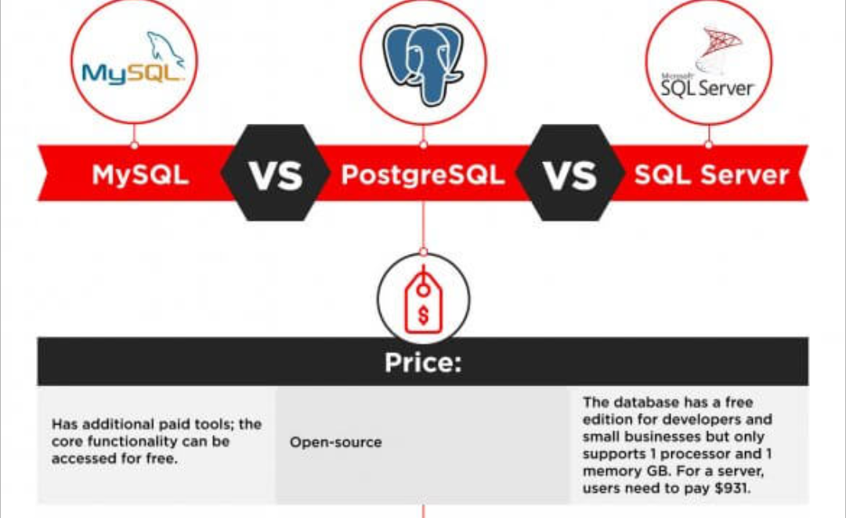
Comparison between this three RDBMS

Slide 7
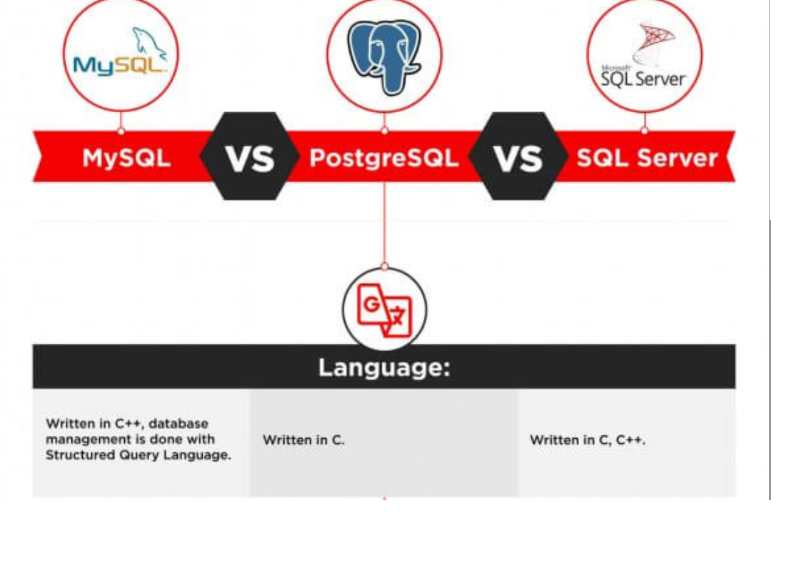
Comparison between this three RDBMS

Slide 8
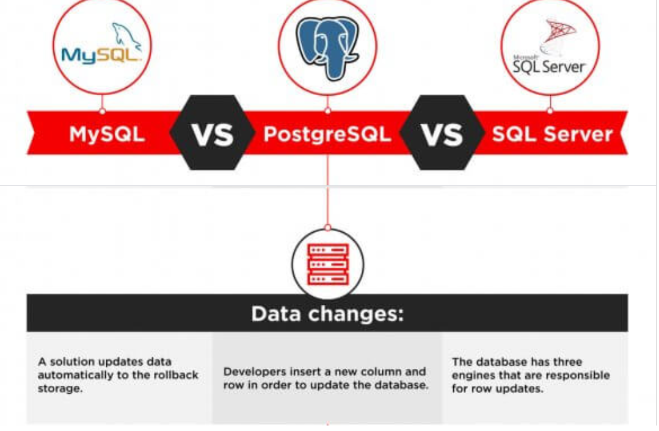
Comparison between this three RDBMS

Slide 9
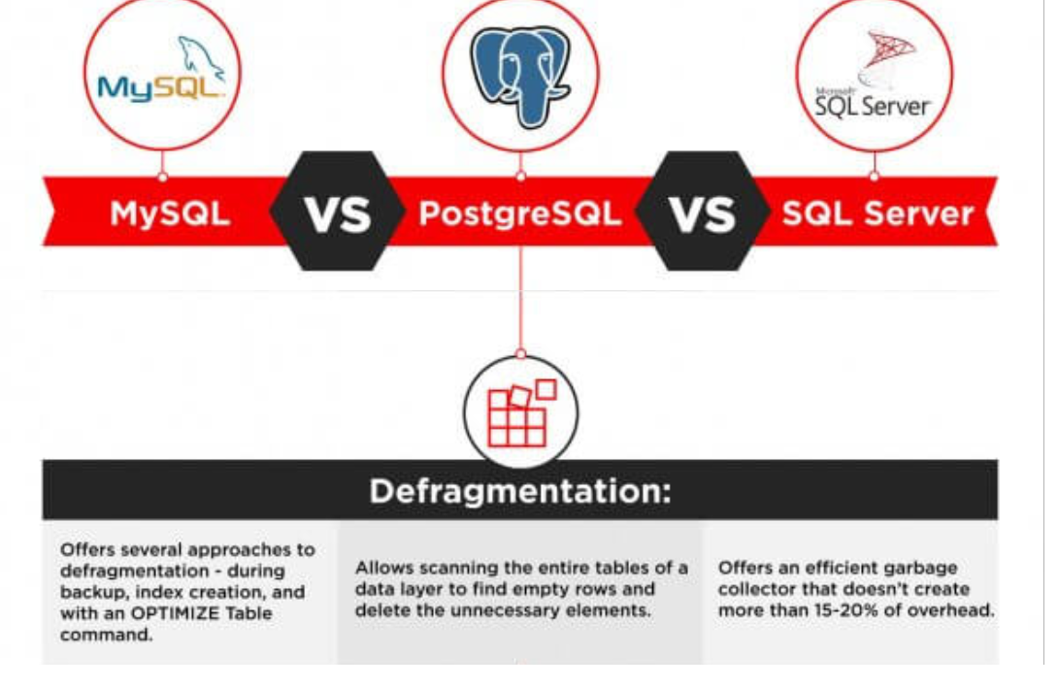
Comparison between this three RDBMS

Slide 10
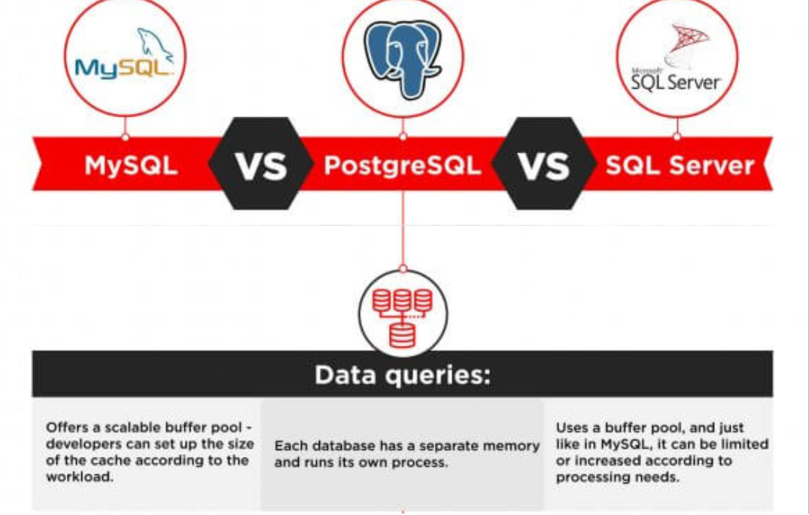
Comparison between this three RDBMS

Slide 11
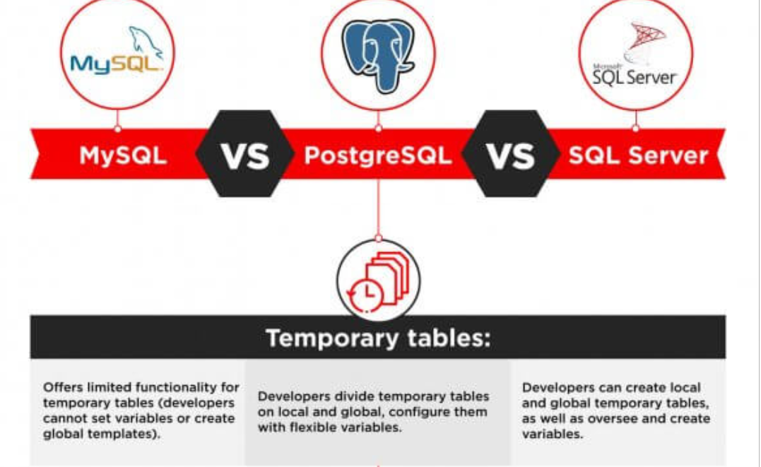
Comparison between this three RDBMS

Slide 12
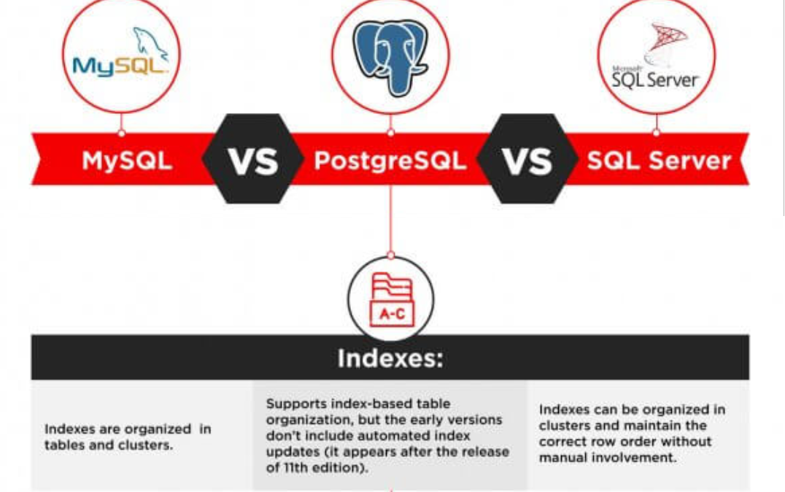
Comparison between this three RDBMS

Slide 13
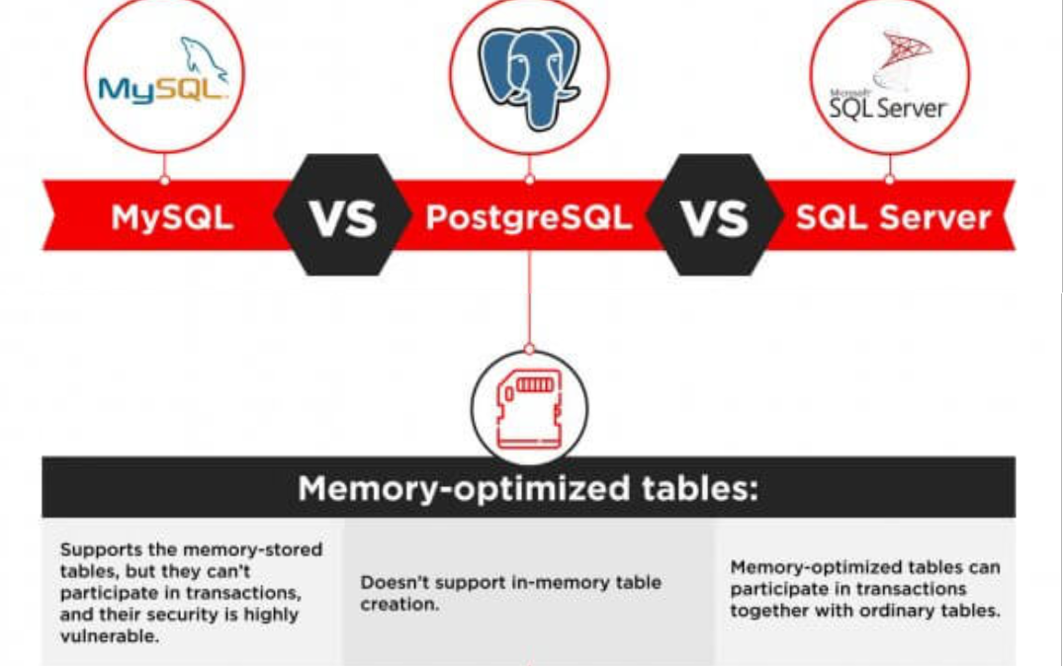
Comparison between this three RDBMS

Slide 14
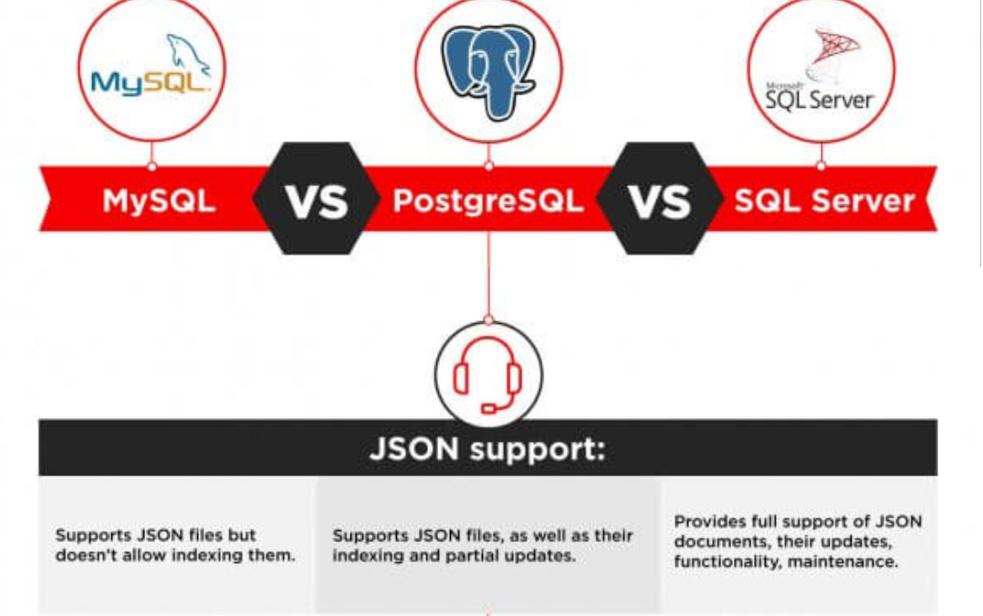
Comparison between this three RDBMS

Slide 15
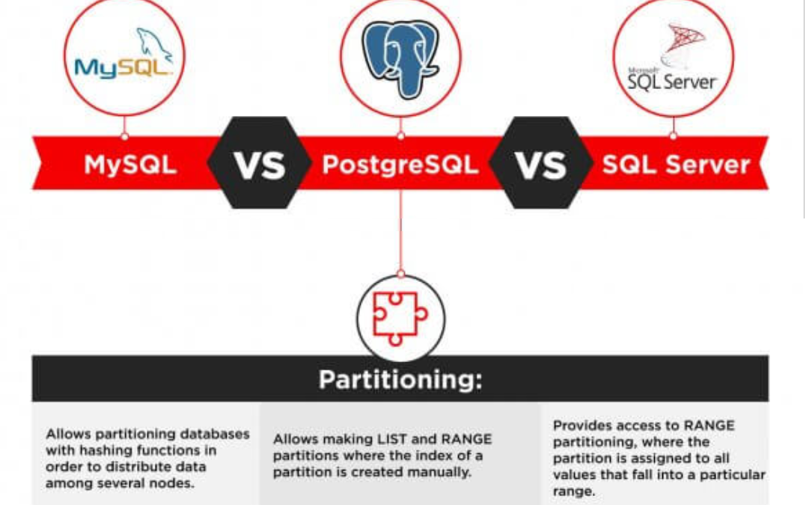
Comparison between this three RDBMS

Slide 16
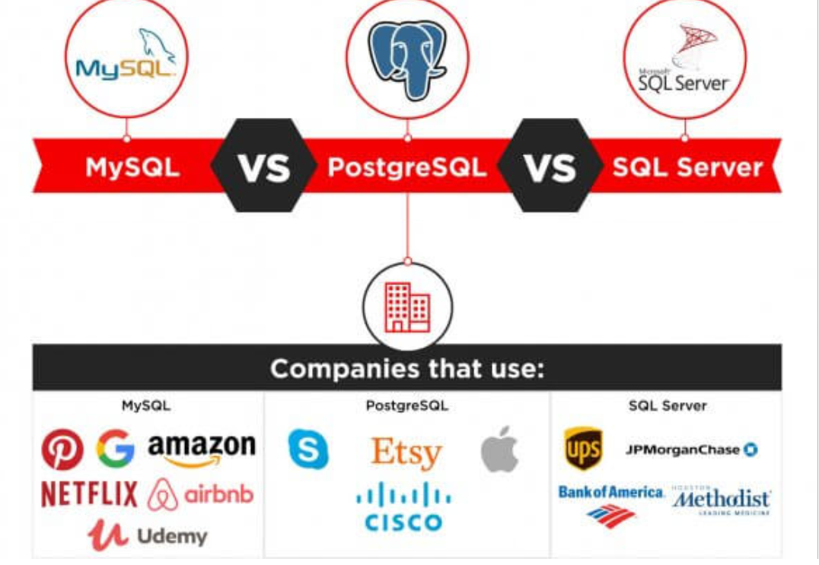
Comparison between this three RDBMS

